Slide 1
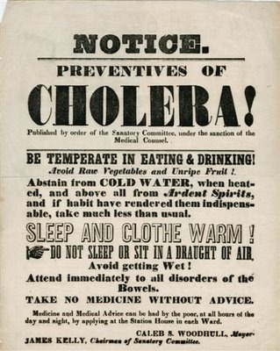
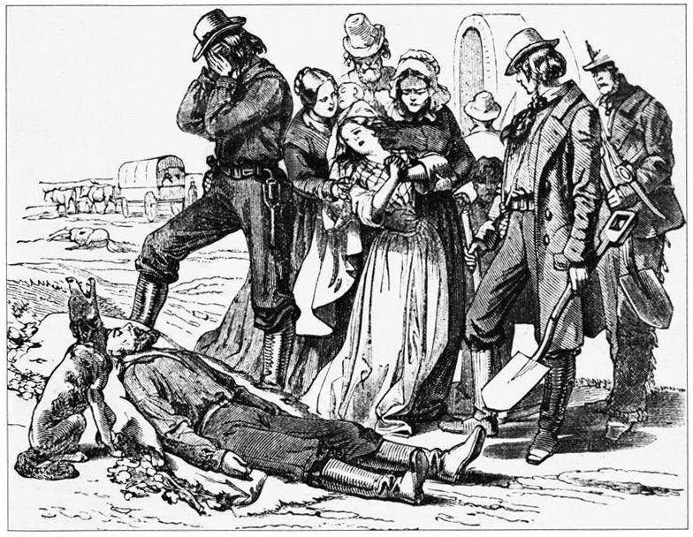
Nashville Cholera Epidemic of 1849-1850
Brochure

Slide 2
Opening facts
Cholera is an acute diarrhoeal infection caused by ingestion of food or water contaminated with the bacterium Vibrio cholerae.
Cholera was believed to be spread in the mid to late 1840s from Irish immigrant ships from England to the United States. It spread throughout the Mississippi river system, killing over 4,500 in St. Louis and over 3,000 in New Orleans.
This was the 2nd leading cause of death in the Nashville City Cemetery Association dataset.
There were at least 300 Nashville city-wide deaths in both 1849 and 1850 with populations of only 10,000 people.
There were 64 recorded deaths from cholera in just the first 4 days of July 1850.

Slide 3
Cholera related deaths, summer of ‘49 &’50

Slide 4
This graph shows the difference between the number of people who resided in country areas vs the number of people who resided in the city and passed from cholera related illnesses. “M” represents male, “F” represents female. These are combined numbers from 1849 and 1850
Rural Residence
Urban Residence
Vs.

Slide 5
This graph represents the age differences of people who passed from cholera related illnesses. These are combined numbers from 1849 and 1850

Slide 6

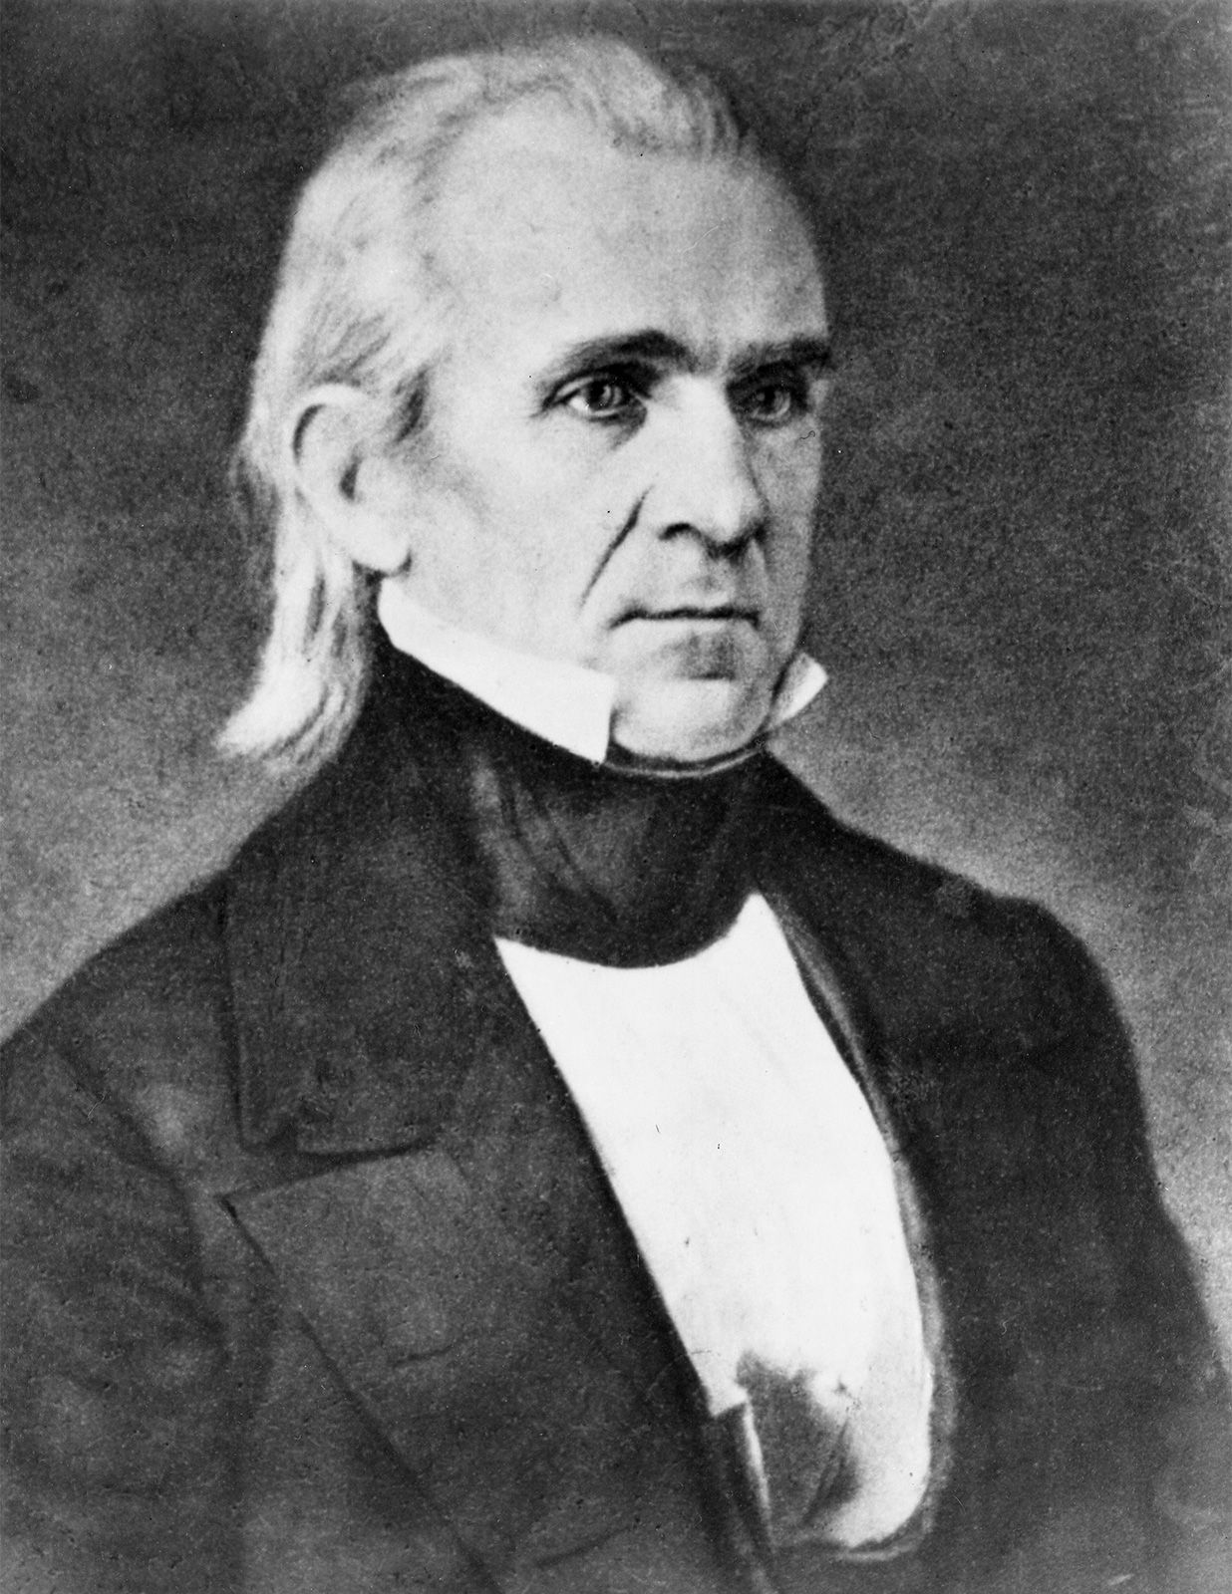

11th president of the United states, James K Polk
In office from March of 1845 to March of 1849
President Polk and his wife Sarah traveled down the Atlantic coast and then westward through the deep south for a prearranged tour that would end in Nashville following his presidential term.
At the end of his travels on Friday, June 15th, 1849, Polk died of cholera at his Polk Place home in Nashville, Tennessee at the age of 53. He passed 103 days after he left office.
Polk's remains have been moved twice. After his death, he was buried in what is now Nashville City Cemetery, due to a legal requirement related to cholera. Polk was then moved to a tomb on the grounds of Polk Place (as specified in his will) in 1850.

